Slide 1

Haptic Interface in a networked virtual environment
Pirmin, Pepijn, Derk & Chevan

Slide 2
Introduction
Haptic device in Unity
Network Research
Research outcome (ALVR)
Network Architecture
Network Degradation
Virtualizing the process

Slide 3
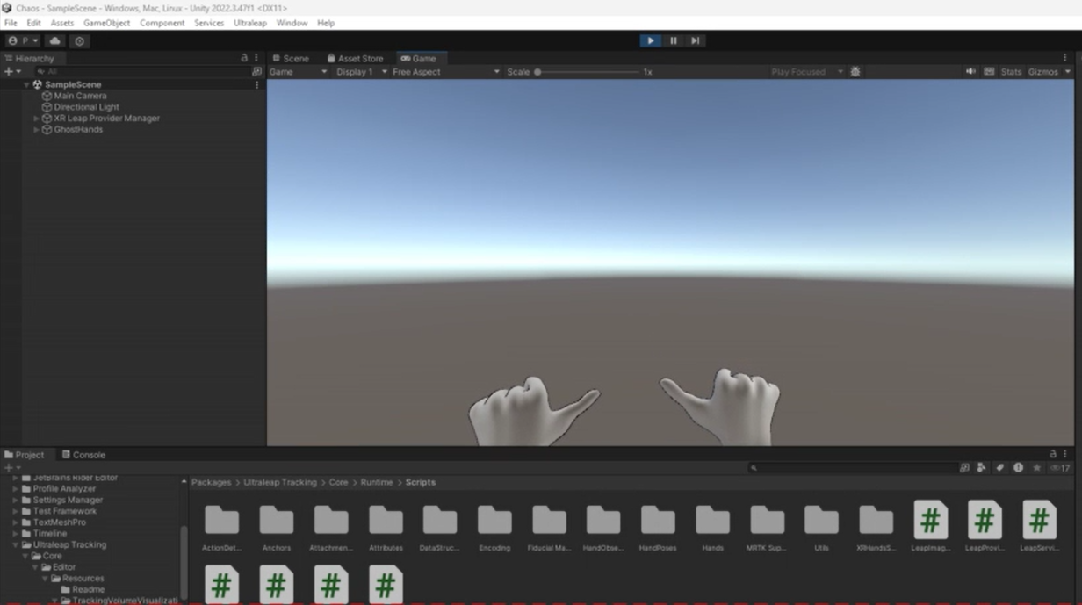
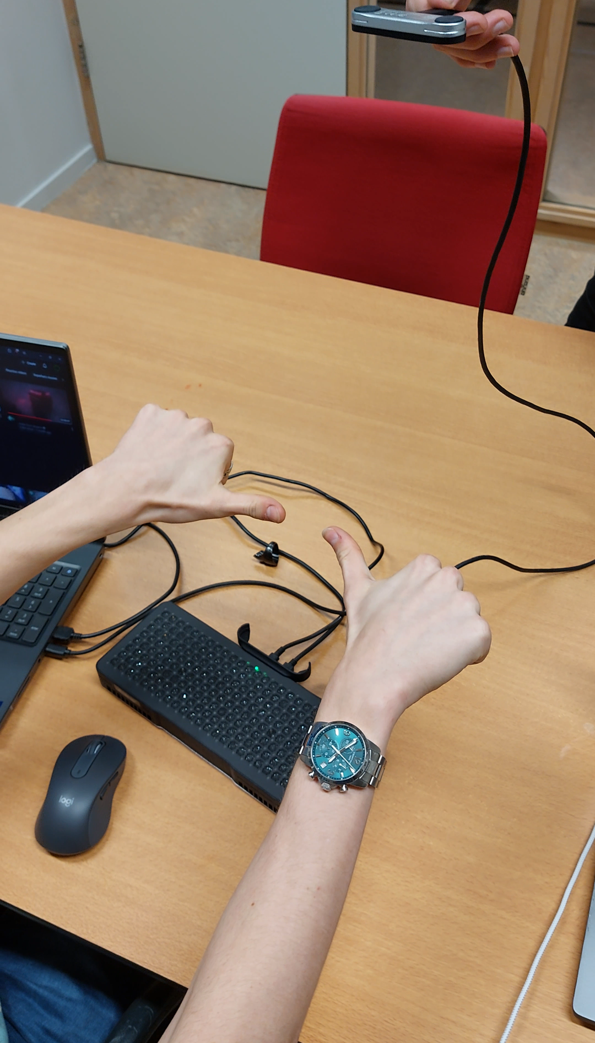
Haptic device in Unity

Slide 4

Network Research
 | NVIDIA CloudXR | ALVR | Moonlight/Parsec (Added later does the same, but supports remote connections natively)
Cost | Paid (closed-source, dev account) | Free & Open-source | Free
Purpose | Professional VR/AR cloud streaming | PC VR wireless streaming to headsets | General game streaming (non-VR focus)
Supported Platforms | Cloud & PC | PC (windows, Linux) | PC (Windows, Linux, macOS)
Wireless Streaming | Yes (optimized for cloud-based VR) | Yes | Yes (but focused on general gaming)
VR Support | Fully optimized for VR & AR | Designed specifically for VR streaming | Not designed for VR
Additional advantage | Clearly supports for cloud | Supports PhoneVR, which can be great for testing. | Ease of setup, with regards to streaming, unsure about the controls (VR), or a second client. Extra laptops needed. Not wireless.

Slide 5
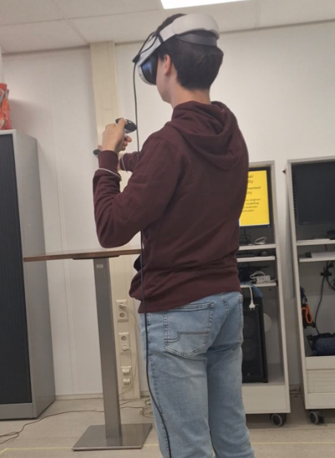
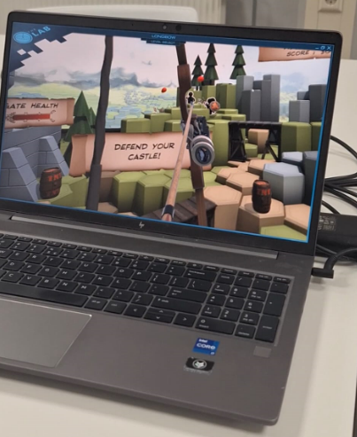
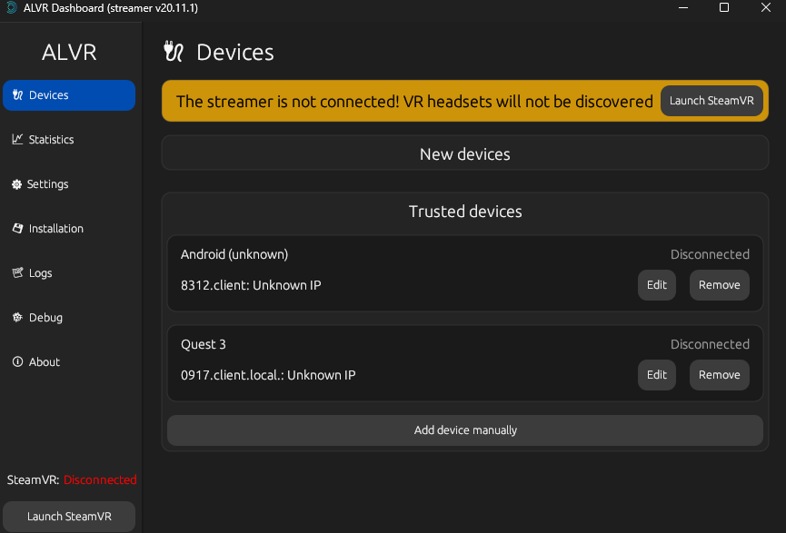
Research outcome (ALVR)

Slide 6
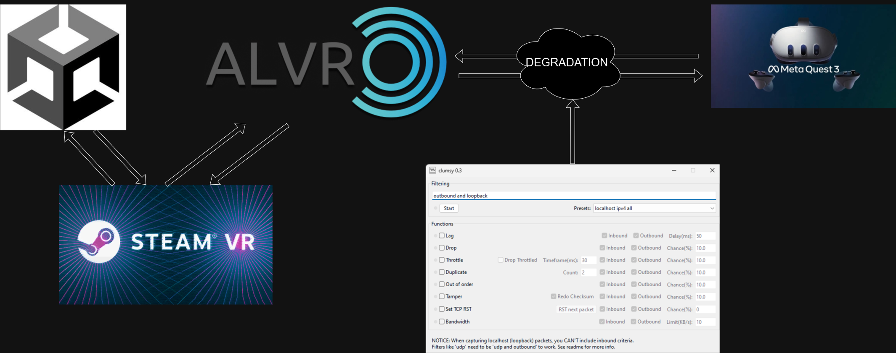
Network

Slide 7
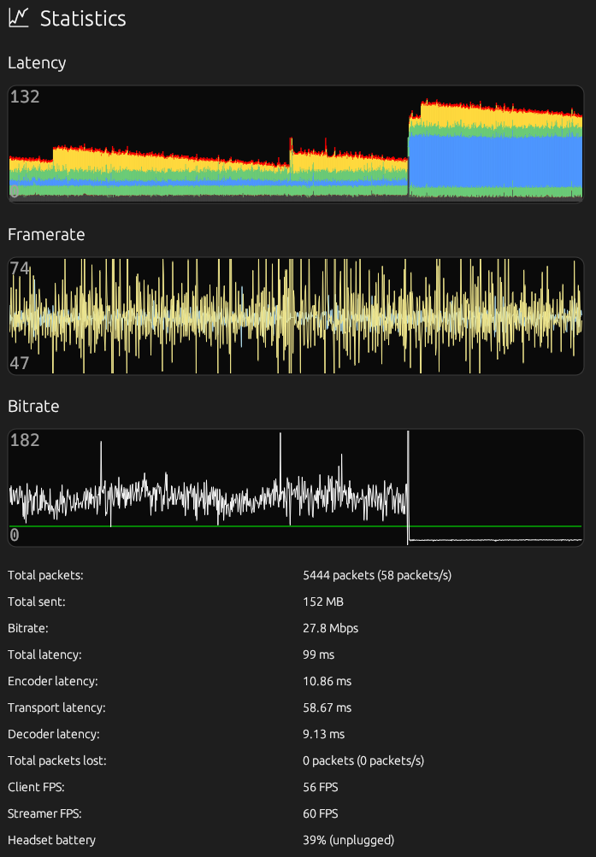
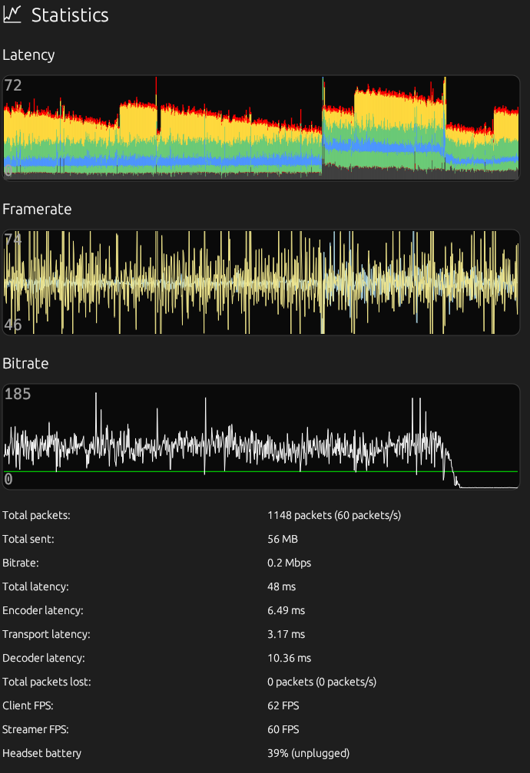
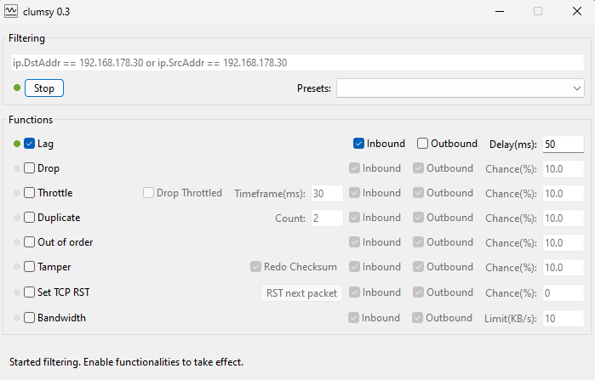
Network degrAdation

Slide 8



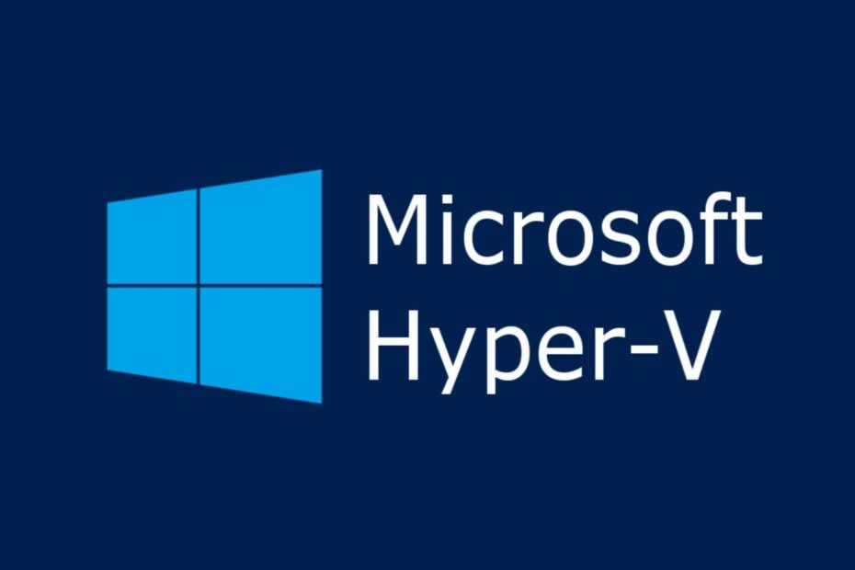
Virtualizing the process
Docker | Oracle VirtualBox | Hyper-V
It is not made for running GUI applications (ALVR) And from people talking on the internet is running the 'game' on docker a big performance hit. | Has no GPU passthrough, meaning we cannot run ALVR or SteamVR. Let alone play a 'game'. | Has no support for vGPU on laptops. "Laptops with NVIDIA GPUs are not supported at this time" Source: https://github.com/jamesstringerparsec/Easy-GPU-PV#prerequisites

